Slide 1
Robot Motion Analysis and Control
Lecture 4
IMSE 381: Industrial Robots
Robot Motion

Slide 2
Robot Motion Analysis
Goal
  Mathematical modeling of the linkage motion of the robot to predict and analyze the positions and motions of the manipulator.
Definitions
  The robot manipulator consists of two basic elements; joints and links.
  Each joint represents one degree of freedom (d.o.f).
  Joints may involve either linear motion or rotational motion between the adjacent links.
  Links are assumed to be the rigid structures that connect the joints.
Robot Motion

Slide 3
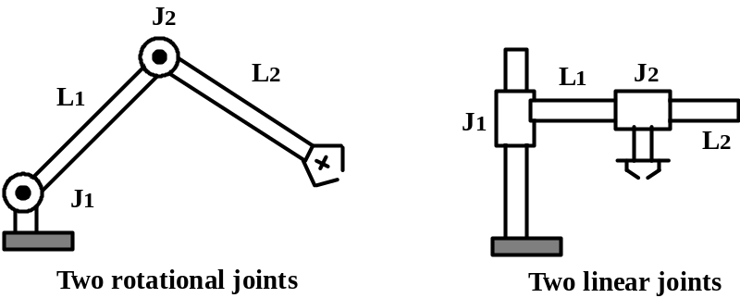
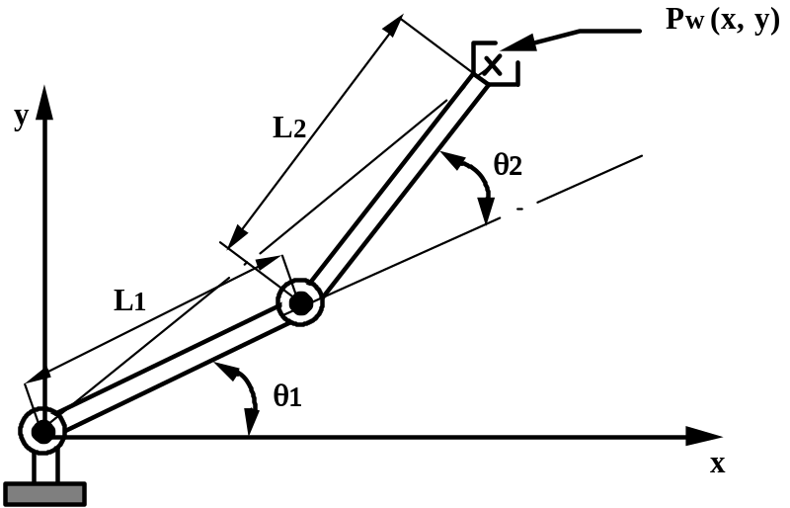
Notation
J_{n} = Label of joint n, n=1 , 2,..
L_{n} = Label of link n, n=1, 2,..
n = 1 is the link closest to base.
Joint space representation
  The position of the end arm in space is defined by:
  Joint coordinates as:
  P_{j} = (θ₁, θ₂)
  World coordinates as:
  P_{w} = (x, y)
Transformations:
  Forward transformation from Joint coordinates to world coordinates
  Reverse Transformations from world coordinates to joint coordinates.
P_{j} = (θ1, θ2)
J₂
J₁
Figure 1
Source: Groover
Robot Motion

Slide 4
Forward Transformation of a 2 D.O.F. Arm
Given: P_{j} = (θ₁, θ₂)
Required: P_{w} = (x, y)
Define a vector for each link 1 & 2
r₁ = [L₁ cos (θ₁), L₁ sin (θ₁)]
r₂= [L₂ cos (θ₁+θ₂), L₂ sin(θ₁+θ₂)]
Hence, the coordinates x and y are:
x = L₁ cos (θ₁) + L₂ cos (θ₁+θ₂) (1)
y = L₁ sin (θ₁) + L₂ sin(θ₁+θ₂) (2)
L₂ sin(θ₁+θ₂)
r₂
r₁
J₂
L₁ sin (θ₁)
J₁
L₁ cos (θ₁)
L₂ cos(θ₁+θ₂)
Figure 2
Robot Motion

Slide 5
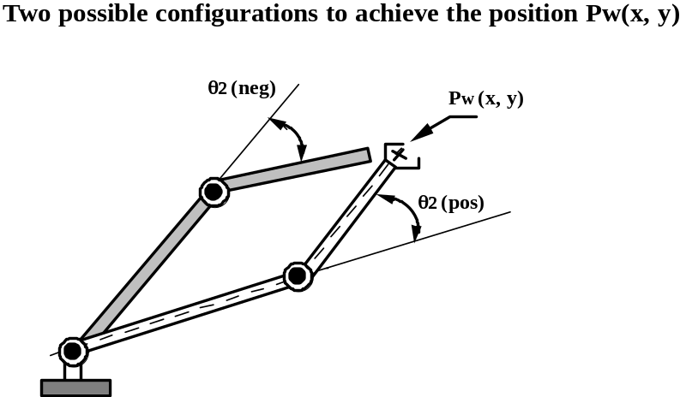
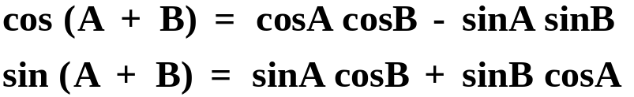
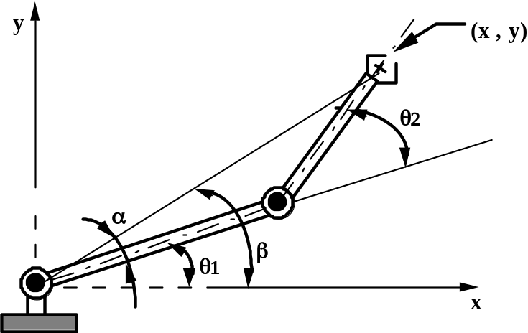

Reverse Transformation of a 2 D.O.F. Arm
Given: P_{w} (x,y)
Required: P_{j} = (θ₁, θ₂)
As shown in the figure, there are two possible configurations to achieve P_{w}(x,y); above and below.
Solving for the Joint Angles
Using trigonometric identities:
ABOVE
BELOW
One can rewrite (1) and (2) as
Figure 3
Robot Motion

Slide 6
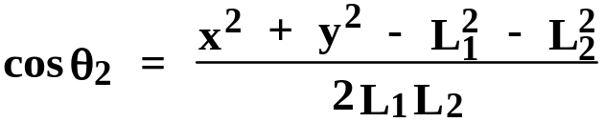
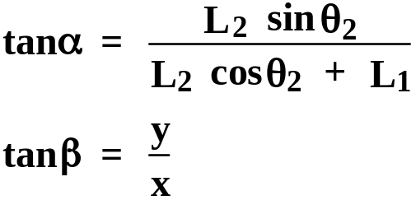
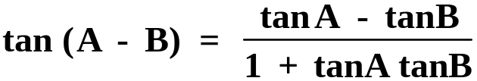
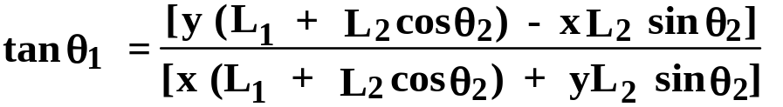
Squaring both sides and adding (3) and (4) yields
From Figure 3 define:
Using the identity
Robot Motion

Slide 7
Example 1
It is desired to determine the values to which angles θ₁ and θ₂ must be set in order to achieve a certain point in space for the manipulator shown in figure. The length of link 1, L₁ = 12 in., the length of link 2, L₂ = 10 in. The point P_{w} which the robot must achieve is defined by the coordinates x = 6.0 and y = 12.0. Using the reverse transformation methods, determine the angles θ₁ and θ₂ required to achieve the point in ABOVE configuration.
Robot Motion

Slide 8
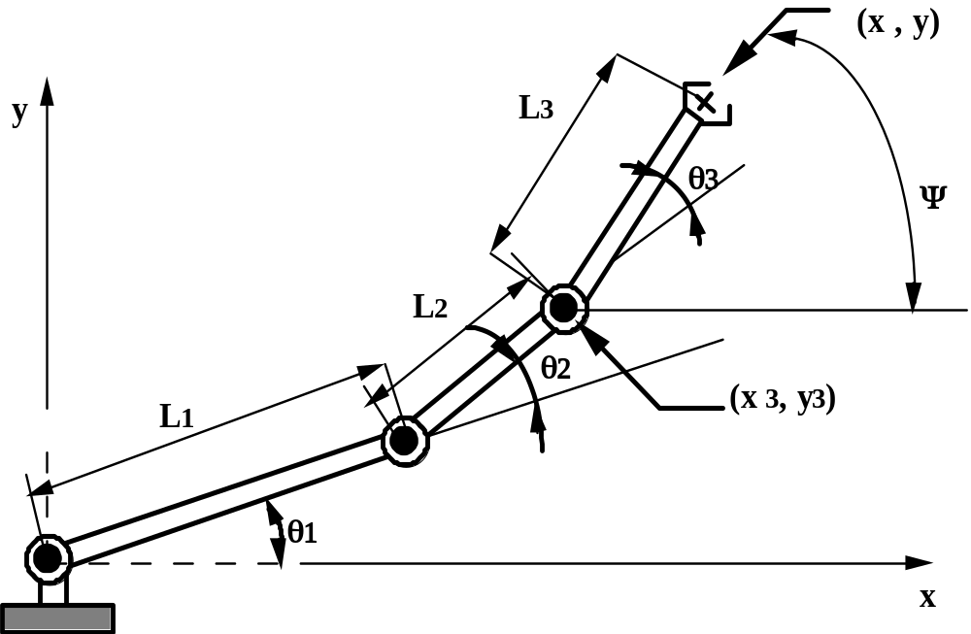
Adding Orientation: A 3 d.o.f. Arm in 2D
Figure 4
Source: Groover
Two - dimensional 3 d.o.f manipulator with orientation
Robot Motion

Slide 9
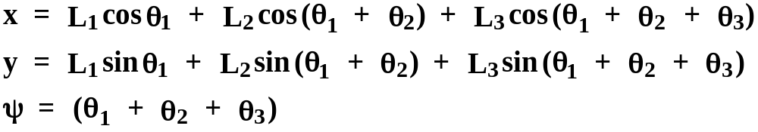
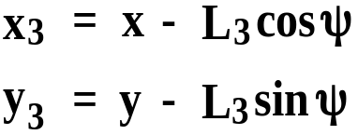
Forward transformation
Given: θ1, θ2, and θ3
Required: x, y, and Ψ
Reverse transformation
Given: x, y, and Ψ
Required: θ1, θ2, and θ3
Determine the position of joint 3 as
Now, determining θ1 and θ2 reduces to the case of the 2 - d.o.f manipulator previously
analyzed.
Robot Motion

Slide 10
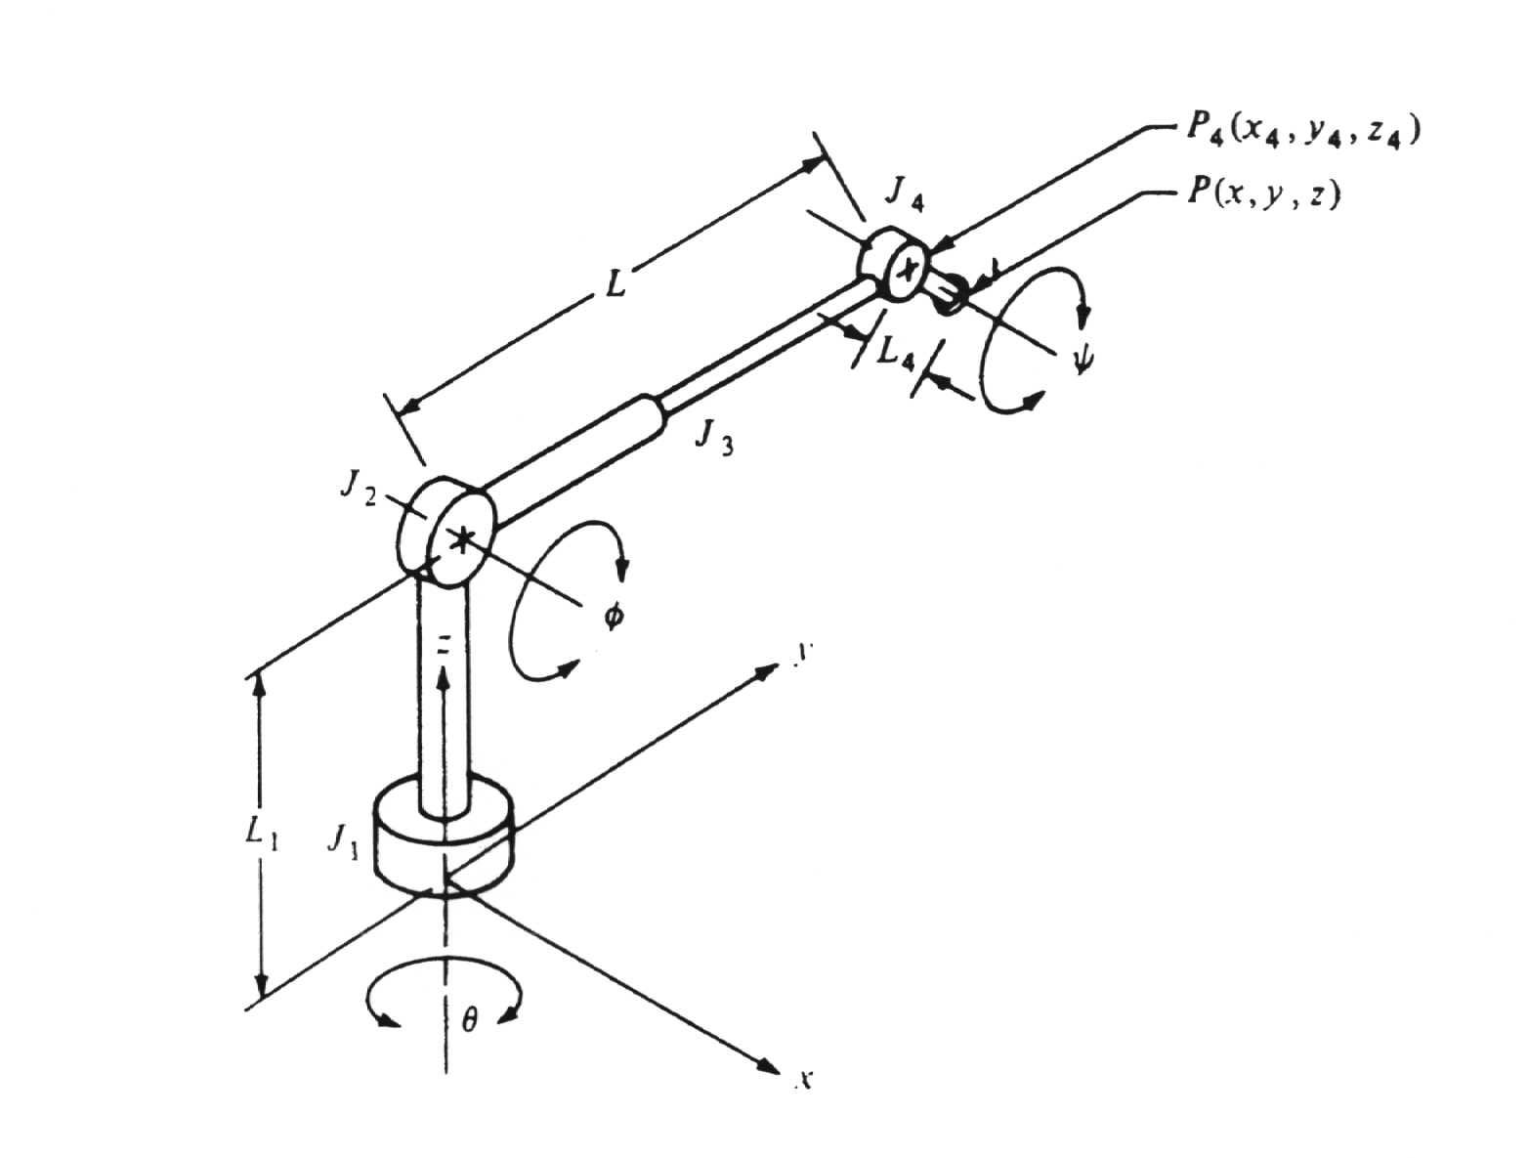
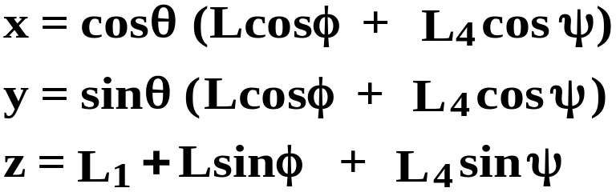
A 4 d.o.f. Manipulator in 3D
Forward Transformation
Given: θ, φ, ψ, L
Required: x, y, z
Solution:
TRL:R
Figure 5
Robot Motion
Notes:
Both Phi and Psi are measured from the horizontal plane while theta is measured from x axis

Slide 11
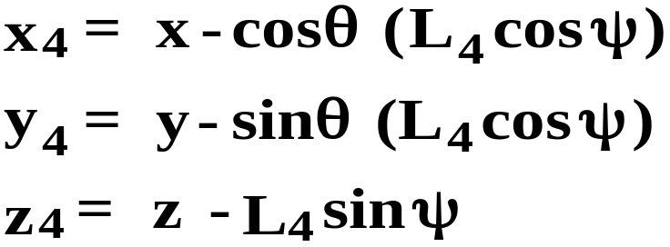
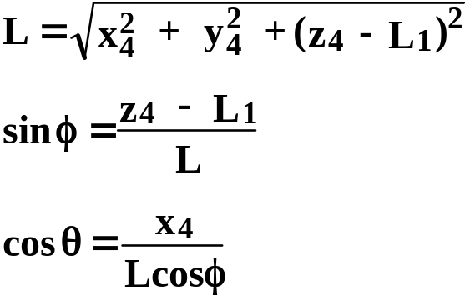
A 4 d.o.f. Manipulator in 3D
Reverse Transformation
Given: P(x, y, z), and pitch angle ψ
Required: θ, φ, L
Using the position of joint 4, P₄(x₄, y₄, z₄)
Thus, we can compute:
Source: Groover
Robot Motion

Slide 12
Example 2
Considering the manipulator shown in the Figure. Suppose the links and joints of the manipulator had the following setting:
Length of link L₁ = 10.0 in.
Length of the extension link L = 15.0 in.
Length of link 4, L₄ = 3.0 in
Base angleθ = 0º
Elevation angle φ = 20º
Pitch angleψ = 34º
Determine the coordinates of the resulting point P at which the end-of-arm would be located.
Robot Motion

Slide 13
Homegeneous Transformations and Robot Kinematics
Homogeneous Transformation: it is desired to represent the transformation as: v’ = Av
where A is the homogeneous transformation matrix and v and v’ are point vectors
Homogeneous representation:
[N space] ➔ [(N+1) space]
i.e. a point v = (x, y, z) is represented as v = (x, y, z, w) where w is a transformation dummy that allows
v’ = A v
The rotation of a point, straight line or an entire image on the screen, about a point other than origin, is achieved by first moving the image until the point of rotation occupies the origin, then performing rotation, then finally moving the image to its original position.
Robot Motion

Slide 14
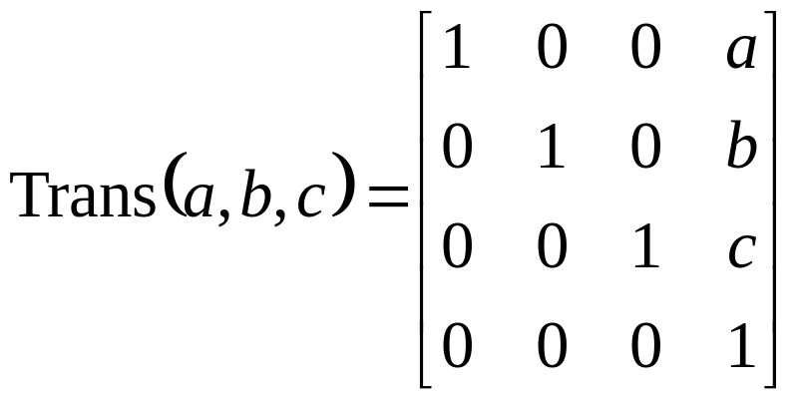
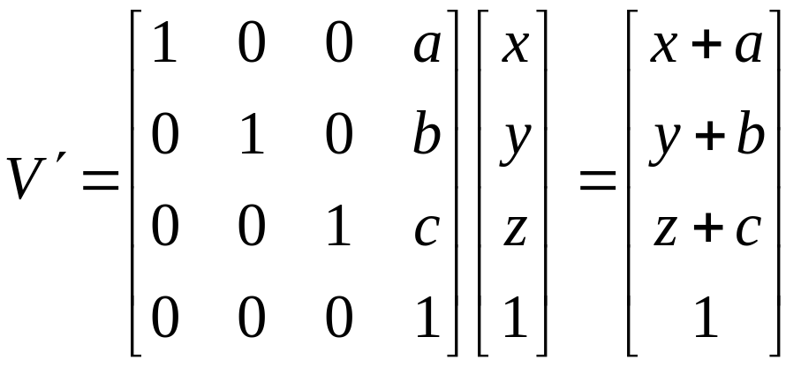
Homogeneous Transformation
Translation by (a, b, c):
C. Lee

Slide 15
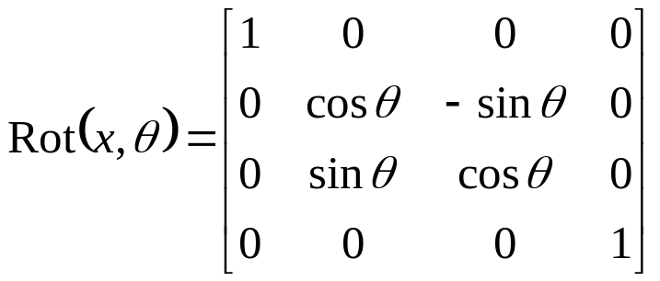
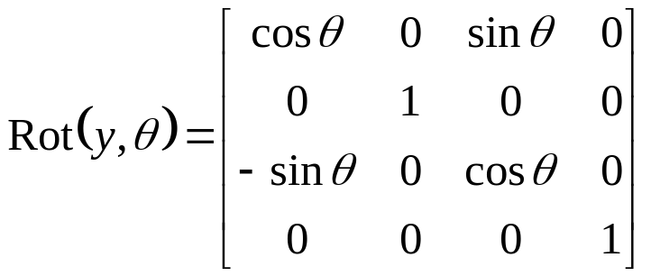
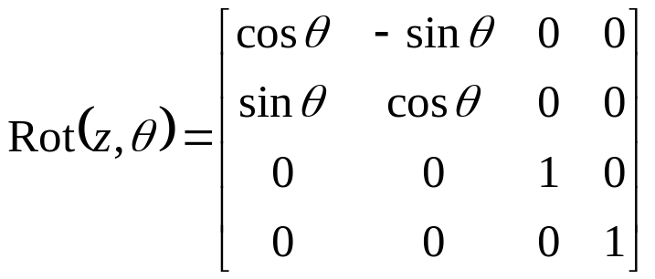
Homogeneous Transformation
Rotation by θ about x, y, and z axis:
C. Lee

Slide 16
Example 3
Rotate the vector v = 5i + 3j + 8k by an angle of 90º about the x axis
Robot Motion

Slide 17
Series of Homogeneous Transformations of a Point
V’ = T V
Translation followed by rotation:
  V’ =Trans ⋅ V
  V” = Rot ⋅ V’
  or V” = Rot ⋅ Trans ⋅V = T ⋅ V
  So T = Rot ⋅ Trans
Trans ⋅ Rot does not equal Rot ⋅ Trans The sequence makes a difference
Example: A point at (1,0,0) is translated by (3,4,5). Then it is rotated 30º about the z-axis. What are the new coordinates of the point?
C. Lee
IMSE 483

Slide 18
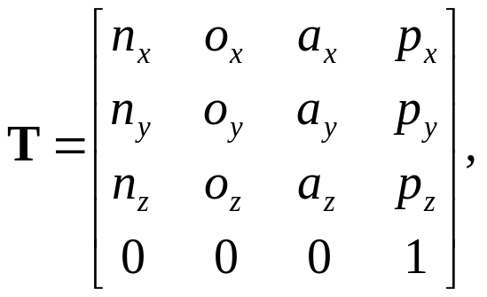
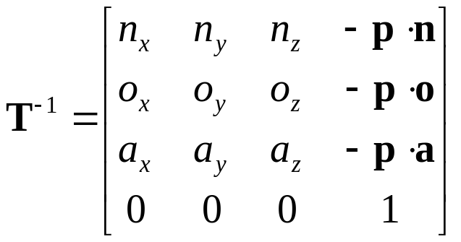
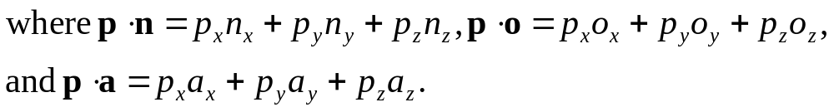
Series of Homogeneous Transformations of a Coordinate Frame (CF)
Consider moving a coordinate frame instead of moving a point. Then, [coordinates of a fixed point wrt old CF] = T ⋅ [coord. of the same point wrt new CF].
Translation followed by rotation of a frame can be achieved by:
T = Trans ⋅ Rot (note the order is reversed from the previous slide)
Rot ⋅ Trans does not equal Trans ⋅ Rot The sequence makes a difference
Inverse Transformation (which undoes the transformation)
Given the inverse transformation is given,
C. Lee

Slide 19
Example 4
Consider the following transformation of a coordinate frame:
“Rotate 30º about Z, then translate 6 along Y”
(a) Find the transformation matrix for the above transformation
(b) Find the inverse matrix for the transformation
(c) Multiply the matrices in (a) and (b)
(d) What are the coordinates of the following points w.r.t. the old frame?
- (1,1,0) w.r.t the new frame
- (0,0,0) w.r.t. the new frame or the new origin
Robot Motion

Slide 20
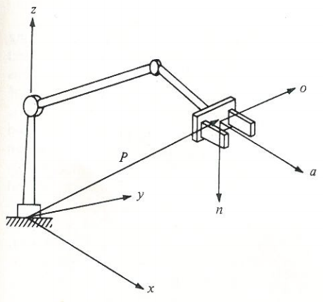
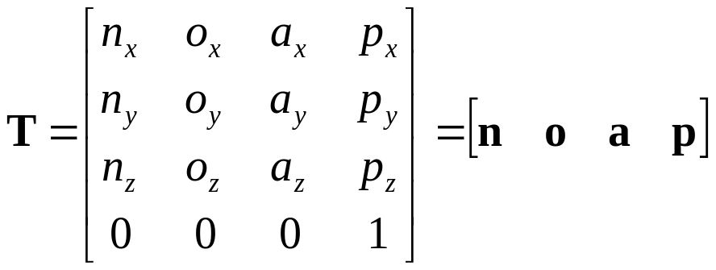
Kinematic Equations Using Homogeneous Transformations
Consider the transformation T again:
Here, p represents the position of the arm end with respect to base frame while n, o, and a specify the orientation of the end effector
T for a Robot with n joints can be obtained by T = A₁ A₂ … A_{n} where A₁ describing the position and orientation of the coordinate frame of the 1st link with respect to the CF of the base and A₂ for the CF of the 2nd link w.r.t. the CF of the 1st link so on.
Source: Groover
Robot Motion

Slide 21
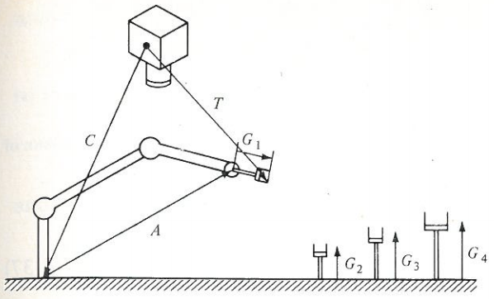
Simple Robot Workcell
Source: Groover
Here the robot’s base frame is related to the camera’s by the transformation C
The robot arm is described by the transformation A (= A₁ A₂ … A_{n}) and the tools by G_{n}
The position of the end of a tool with respect to the camera’s base frame would be given by:
T = C A G_{n}
C and G_{n}’s are constants and obtained via calibration.
Once a part position or target position T is sensed by the vision sensor, the robot controller will set A such that A = C⁻¹ T G_{n}⁻¹
Robot Motion

Slide 22
Manipulator Path Control
Motion Types:
  Slew Motion
  Joint Interpolation Motion
  Straight Line Motion
Slew Motion
  Under this motion, when robot commanded to travel from point A to point B, each axis of the manipulator travels as quickly as possible from its respective initial position to its required final position. Therefore, all axes begin moving at the same time, but each axis ends its motion in an elapsed time that is proportional to its distance moved divided by its top speed.
  Disadvantages:
    Results in unnecessary wear on the joints.
    Often leads to unanticipated results in terms of the path taken by the manipulator.
Robot Motion

Slide 23
Example 5
Determine the time required for each joint of three-axis manipulator to travel the following distances using slew motion: joint 1, 30°; joint 2, 60°, and joint 3, 90°. All joints travel at a rotational velocity of 30°/s.
Solution
Joint 1 will complete its move in 30°/(30°/s) = 1 s,
Joint 2, in 60°/(30°/s) = 2 s,
Joint 3, in 90°/(30°/s) = 3 s.
Robot Motion

Slide 24
Joint Interpolated Motion
This motion requires the robot controller to calculate the amount of time it will take each joint to reach its destination at the commanded speed. It then selects the maximum time among these, and uses this value as the time for all the axes, meaning that a separate velocity is calculated for each axis.
  Advantage:
    The joints are driven at less than their respective maximum velocities, thus reducing the maintenance problems for a robot.
    The path that is followed by the manipulator is repeatable and predictable.
Robot Motion

Slide 25
Example 6
Determine the time required to complete the move and the velocity of each joint for three-axis manipulator, considered in the previous example, to travel the following distances under joint-interpolated motion: joint 1, 30°; joint 2, 60°, and joint 3, 90°. The maximum velocity of any joint is 30°/s; no joint may travel at greater then 90% of maximum velocity.
Solution
Since, Joint 3 has the longest distance to travel and therefore will result in the maximum time to complete its move. The time for joint 3 to travel the 90° is: 90°/(0.9 × 30°/s) = 3.33 s
The velocity for joint 1 is: 30°/3.33 s = 9.0°/s
The velocity for joint 2 is: 60°/3.33 s = 18.0°/s
Robot Motion

Slide 26
Straight Line Motion
This motion requires the end of the manipulator to travel along a straight path defined in Cartesian coordinates.
The command rate should be at least ten time the natural frequency of the joint to avoid vibration.
Advantages
  Very useful in applications such as:
    arc welding
    laying adhesives along a straight path
    inserting a peg in a hole in assembly
Robot Motion

